Slide 1
Introduction and Creating First App
Musadaq Mansoor
(Credits to Marty Stepp and Stanford Computer Science)

Slide 2
What is Android
mobile operating system maintained by Google
– originally purchased from Android, Inc. in 2005 ●
runs on phones, tablets, watches, TVs, ...
based on Java (dev language) and Linux (kernel)
the #1 mobile OS worldwide – and now #1 overall OS worldwide!
has over 1 million apps published in Play Store
code is released as open source (periodically) – easier to customize, license, pirate, etc. than iOS

Slide 3
Why develop for Android
Why not just write a web site? Android has a browser
better, snappier UI with a more consistent user experience
able to use different kinds of widgets/controls than in a web page
more direct access to the device's hardware (camera, GPS, etc.)
users highly prefer apps over mobile web browsing

Slide 4
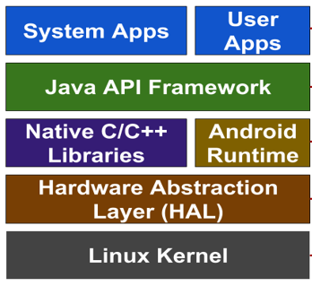
Android Architecture

Slide 5
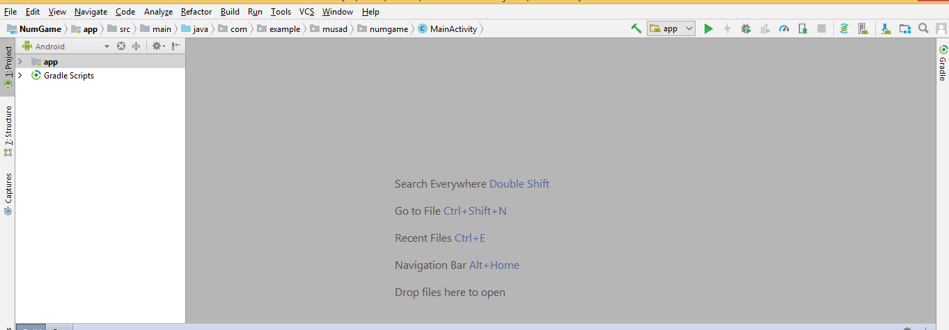
Android Studio
Google's official Android IDE, in v1.0 as of November 2014
replaces previous Eclipse-based environment
based on IntelliJ IDEA editor; free to download and use

Slide 6
Project Structure
AndroidManifest.xml
overall project config and settings
src/java/...
source code for your Java classes
res/... = resource files (many are XML)
drawable/ = images
layout/ = descriptions of GUI layout
menu/ = overall app menu options
values/ = constant values and arrays
strings = localization data
styles = general appearance styling

Slide 7
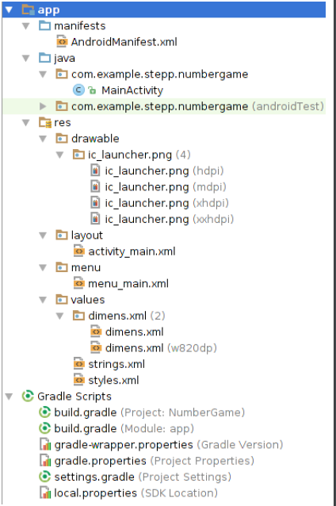
Project Structure
Gradle
a build/compile management system
build.gradle = main build config file

Slide 8
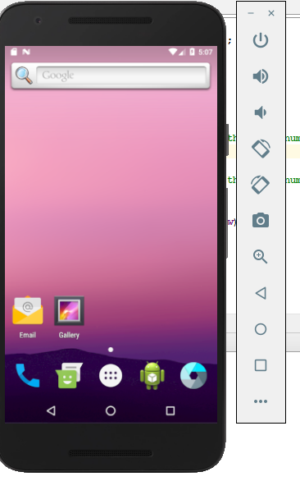
Virtual Devices (AVDs)
allows you to run your project in an emulator
a software simulation of an entire Android tablet, phone, watch
when you click the "Run" button in Android Studio, it builds your app, installs it on the virtual device, and loads it
alternative: install your app on your actual Android device!

Slide 9
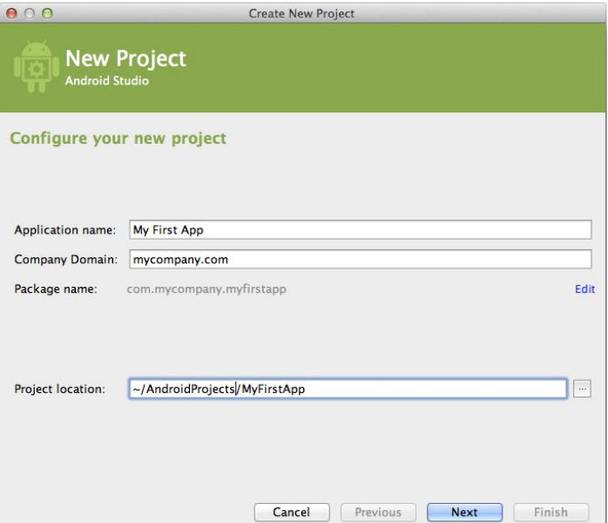
Create New Project

Slide 10
Android Terms
activity: a single screen of UI that appears in your app – the fundamental units of GUI in an Android app
view: items that appear onscreen in an activity
widget: GUI control such as a button or text field
layout: invisible container that manages positions/sizes of widgets
event: action that occurs when user interacts with widgets – e.g. clicks, typing, scrolling
action bar: a menu of common actions at top of app
notification area: topmost system menu and icons

Slide 11
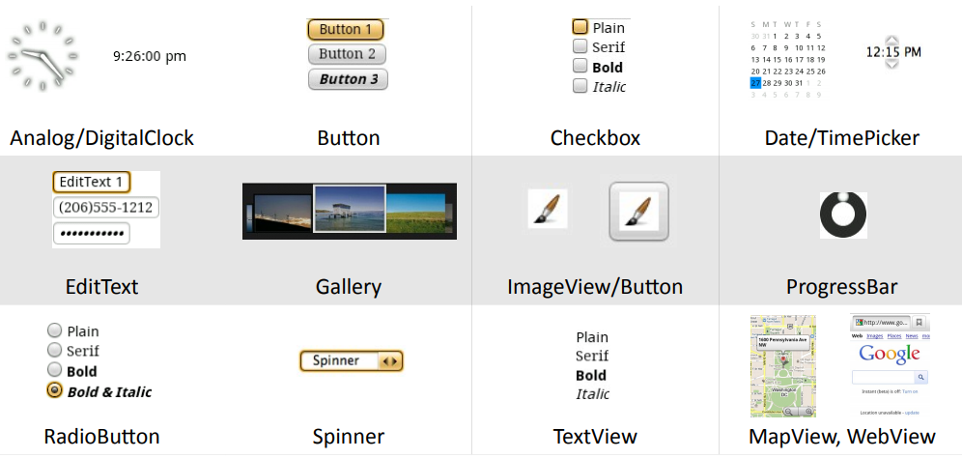
Android Widgets

Slide 12
User Interface
open XML file for your layout (e.g. activity_main.xml)
drag widgets from left Palette to the preview image
set their properties in lower-right Properties panel

Slide 13
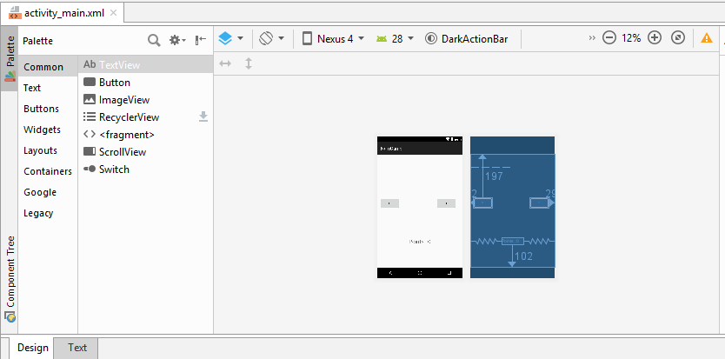

Slide 14
Events
event: An external stimulus your program can respond to.
Common kinds of events include:
Mouse motion / tapping, Keys pressed
Timers expiring, Network data available
event-driven programming: Overall execution of your program is largely dictated by user events.
Commonly used in graphical programs.
To respond to events in a program, you must:
Write methods to handle each kind of event ("listener" methods).
Attach those methods to particular GUI widgets.

Slide 15
Setting an event listener
select the widget in the Design view
scroll down its Properties until you find onClick
type the name of a method you'll write to handle the click
switch to the Text view and find the XML for that button
click the "Light Bulb" and choose to "Create" the method

Slide 16
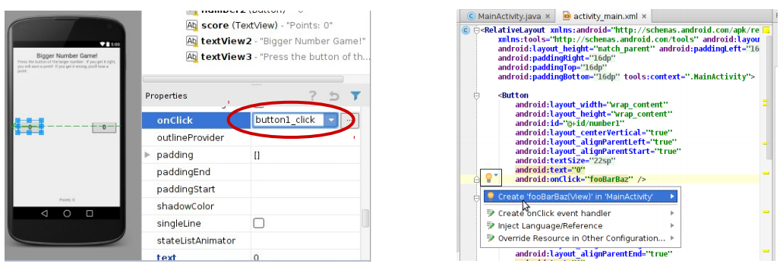

Slide 17
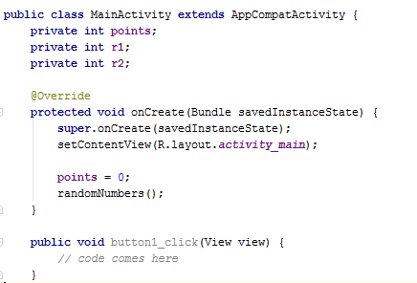
Event Listener Java Code

Slide 18
View Objects
each widget has an associated Java object you can access
they are subclasses of parent class View
examples: Button, TextView, EditText, ...
View objects have many get and set methods that correspond to the properties in the Design view:
background, bottom, ID, left, margin, padding, right, text, textAlignment, textSize, top, typeface, visibility, x, y, z, ...
example: for a Button's text property, there will be methods: public String getText() public void setText(String text)

Slide 19
Interacting with Widgets
accessing a widget in the Java code:
in Design view, give that view a unique ID property value
in Java code, call findViewById to access its View object
pass it a parameter of R.id.your_unique_ID
cast the returned value to the appropriate type (Button, TextView, etc.)
public void button1_onclick(View view) {
TextView tv = (TextView) findViewById(R.id.mytextview); tv.setText(“Here you go!"); }

Slide 20
Demo: Build the App

Slide 21
Toasts
Toast.makeText(this,
"message",
duration).show();
where duration is Toast.LENGTH_SHORT or LENGTH_LONG
A "Toast" is a pop-up message that appears for a short time.
Useful for displaying short updates in response to events.
Should not be relied upon extensively for important info.

Slide 22
Thanks
Any Questions?

